Slide 1
Chapter 4: Network Access
Introduction to Networks v5.1

Slide 2
Chapter Outline
4.0 Introduction
4.1 Physical Layer Protocols
4.2 Network Media
4.3 Data Link Layer Protocols
4.4 Media Access Control
4.5 Summary

Slide 3
Section 4.1: Physical Layer Protocols
Upon completion of this section, you should be able to:
Identify device connectivity options.
Describe the purpose and functions of the physical layer in the network.
Describe basic principles of the physical layer standards.

Slide 4
Topic 4.1.1: Physical Layer Connection

Slide 5
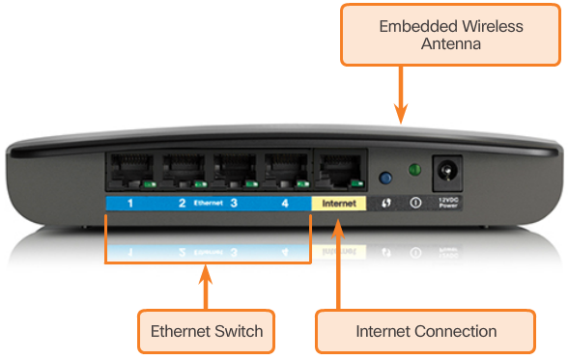
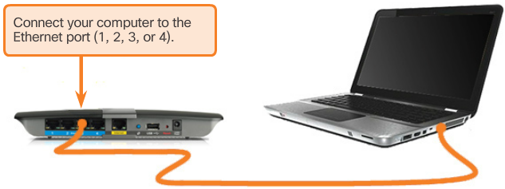
Types of Connections
Home Router
Connecting to the Wired LAN
Notes:
4.1.1.1 Types of Connections

Slide 6
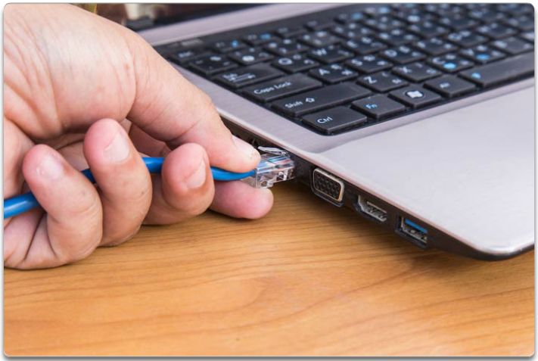
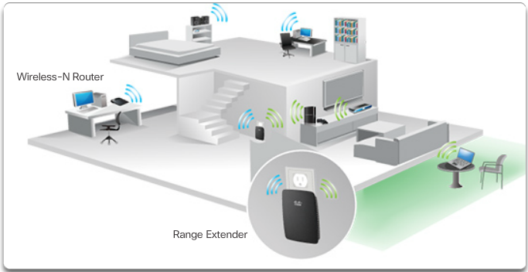
Network Interface Cards
Wired Connection Using an Ethernet NIC
Connecting to the Wireless LAN with Range Extender
Notes:
4.1.1.2 Network Interface Cards

Slide 7
Topic 4.1.2: Purpose of the Physical Layer

Slide 8
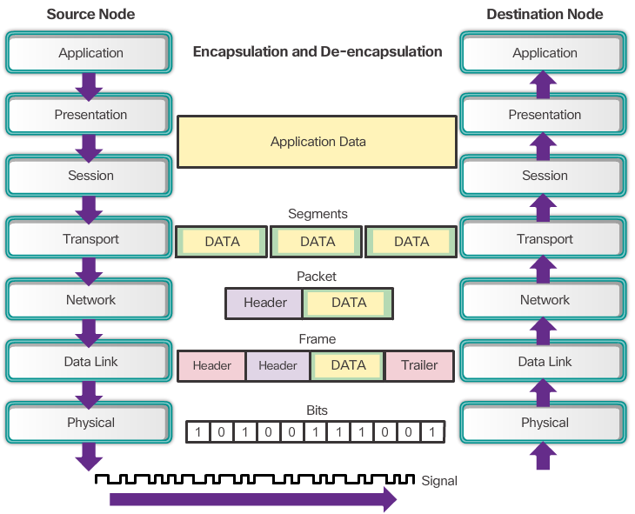
The Physical Layer
Notes:
4.1.2.1 The Physical Layer

Slide 9
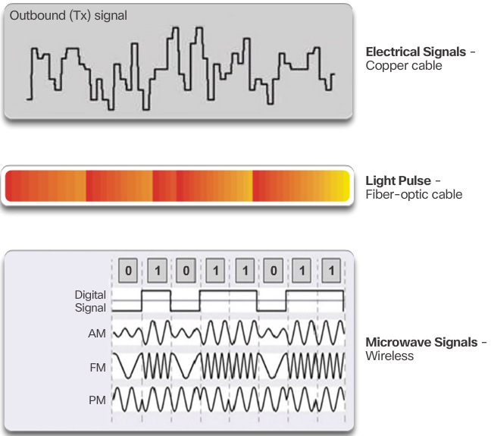
Physical Layer Media
Notes:
4.1.2.2 Physical Layer Media

Slide 10
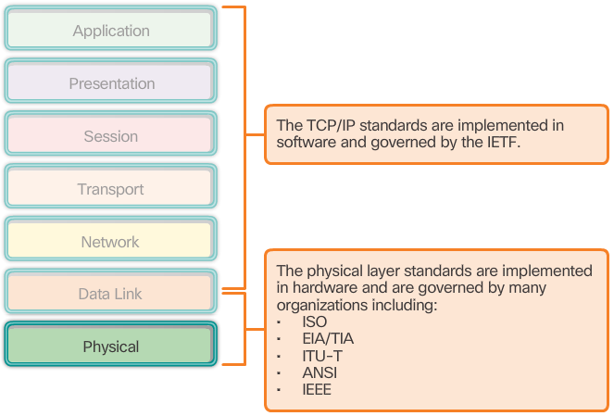
Physical Layer Standards
Notes:
4.1.2.3 Physical Layer Standards
4.1.2.4 Lab – Identifying Network Devices and Cabling

Slide 11
Topic 4.1.3: Physical Layer Characteristics

Slide 12
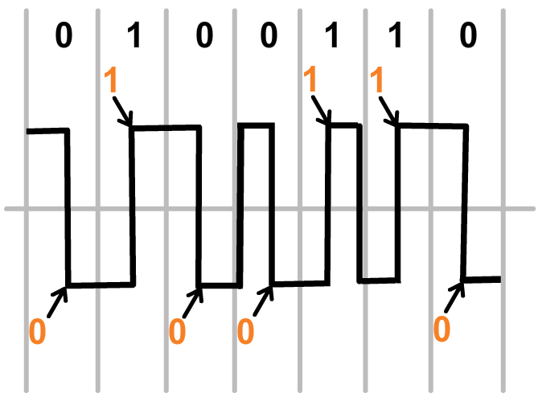
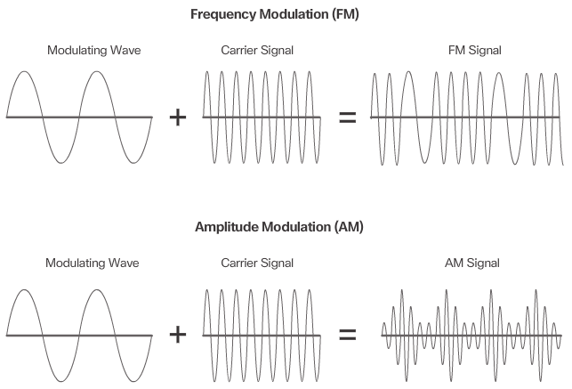
Functions
Manchester Encoding
Modulation
Notes:
4.1.3.1 Functions

Slide 13
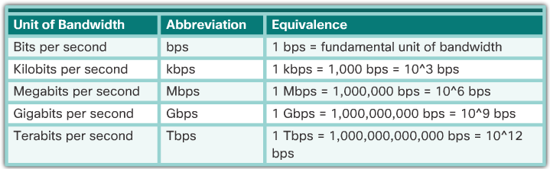
Bandwidth
Notes:
4.1.3.2 Bandwidth

Slide 14
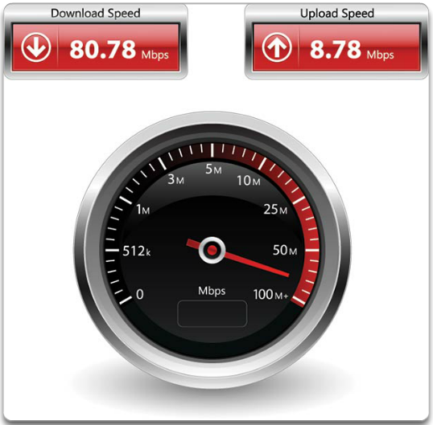
Throughput
Notes:
4.1.3.3 Throughput

Slide 15
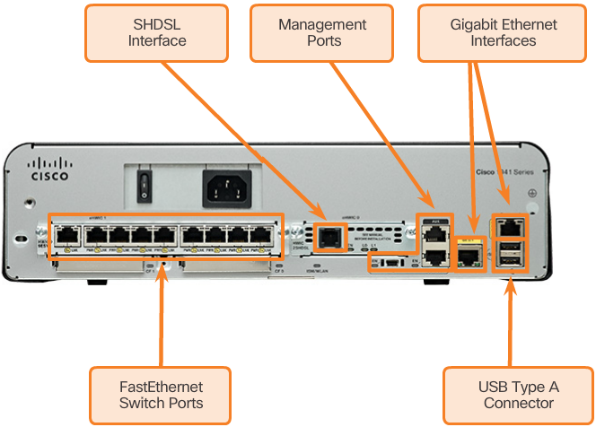
Types of Physical Media
Notes:
4.1.3.4 Types of Physical Media
4.1.3.5 Activity – Physical Layer Terminology

Slide 16
Section 4.2: Network Media
Upon completion of this section, you should be able to:
Identify the basic characteristics of copper cabling.
Build a UTP cable used in Ethernet networks (scope – does not include cabling area discussion).
Describe fiber-optic cabling and its main advantages over other media.
Connect devices using wired and wireless media.

Slide 17
Topic 4.2.1: Copper Cabling

Slide 18
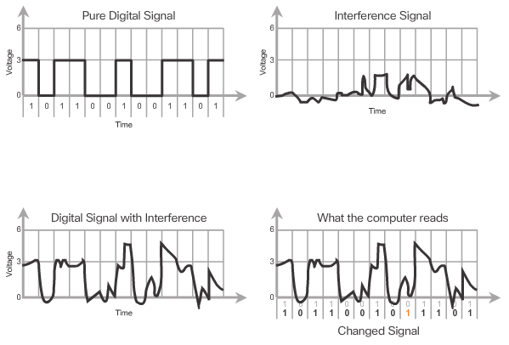
Characteristics of Copper Cabling
Notes:
4.2.1.1 Characteristics of Copper Cabling

Slide 19
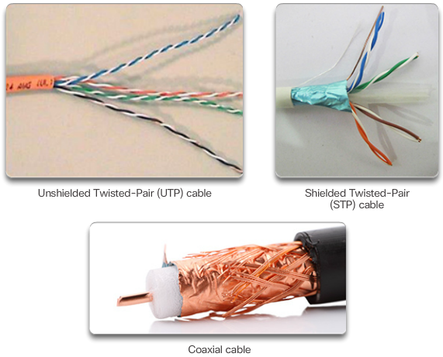
Copper Media
Notes:
4.2.1.2 Copper Media

Slide 20
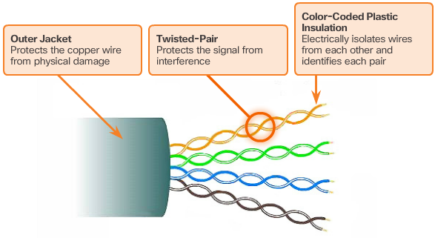
Unshielded Twisted-Pair Cable
Notes:
4.2.1.3 Unshielded Twisted-Pair Cable

Slide 21
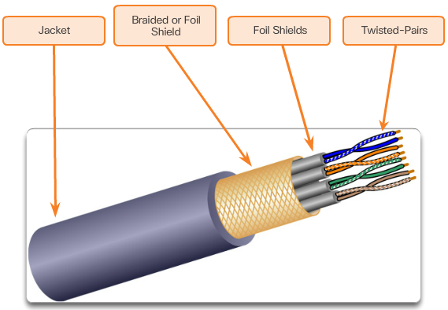
Shielded Twisted-Pair Cable
Notes:
4.2.1.4 Shielded Twisted-Pair Cable

Slide 22
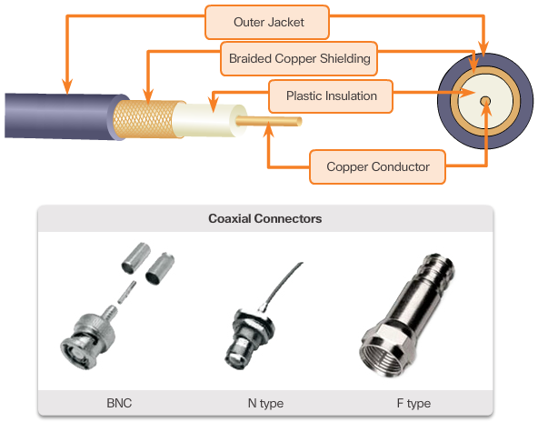
Coaxial Cable
Notes:
4.2.1.5 Coaxial Cable

Slide 23
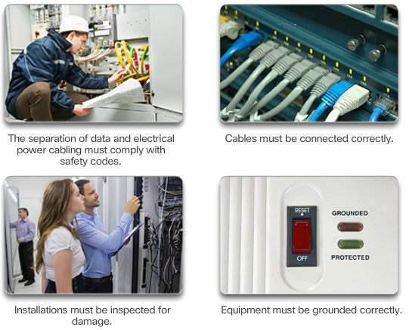
Copper Media Safety
Notes:
4.2.1.6 Copper Media Safety
4.2.1.7 Activity – Cooper Media Characteristics

Slide 24
Topic 4.2.2: UTP Cabling

Slide 25
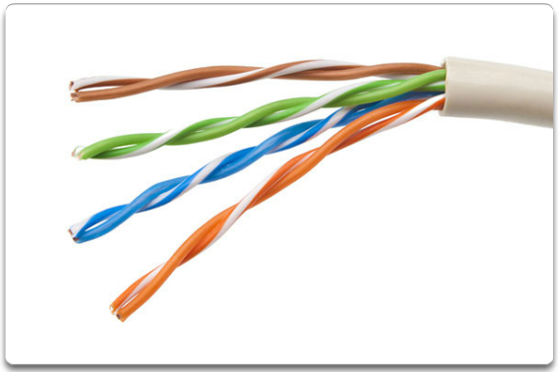
Properties of UTP Cabling
Notes:
4.2.2.1 Properties of UTP Cabling

Slide 26
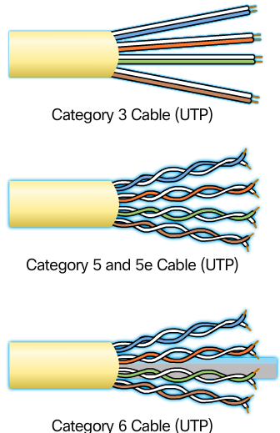
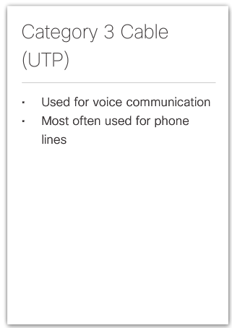
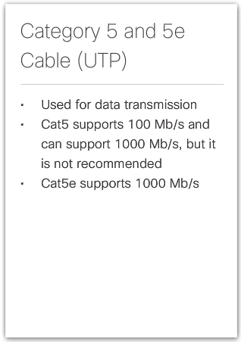
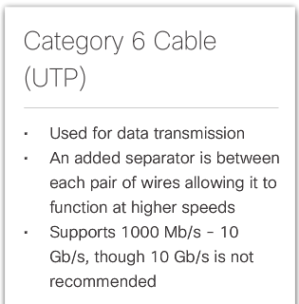
UTP Cabling Standards
Notes:
4.2.2.2 UTP Cabling Standards

Slide 27
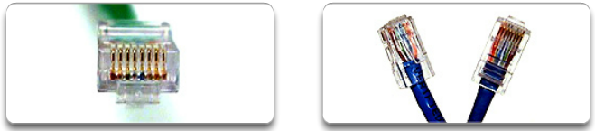
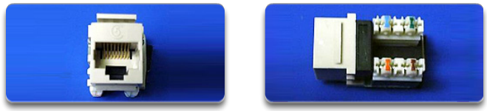
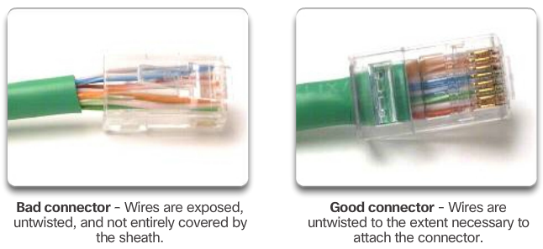
UTP Connectors
RJ-45 UTP Plugs
RJ-45 UTP Socket
Notes:
4.2.2.3 UTP Connectors

Slide 28
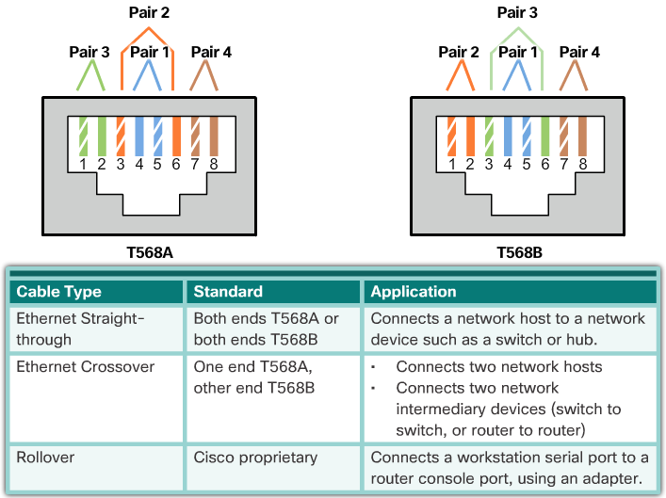
Types of UTP Cable
Notes:
4.2.2.4 Types of UTP Cable

Slide 29
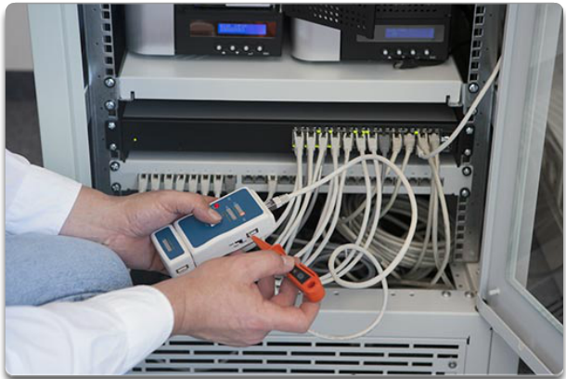
Testing UTP Cables
UTP Testing Parameters:
Wire map
Cable length
Signal loss due to attenuation
Crosstalk
Notes:
4.2.2.5 Testing UTP Cables
4.2.2.6 Activity – Cable Pinouts
4.2.2.7 Lab – Building an Ethernet Crossover Cable

Slide 30
Topic 4.2.3: Fiber Optic Cabling

Slide 31
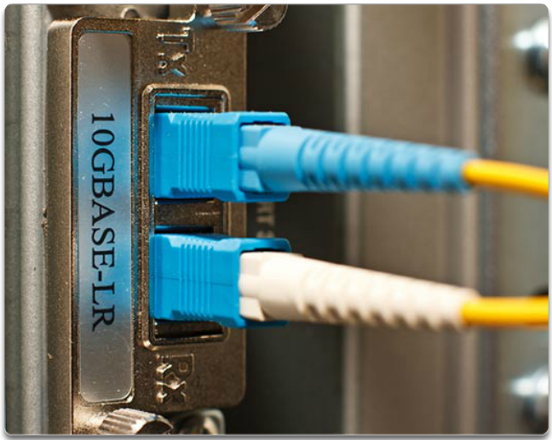
Properties of Fiber Optic Cabling
Notes:
4.2.3.1 Properties of Fiber Optic Cabling

Slide 32
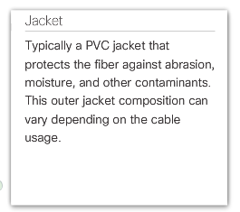
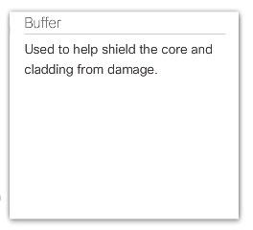
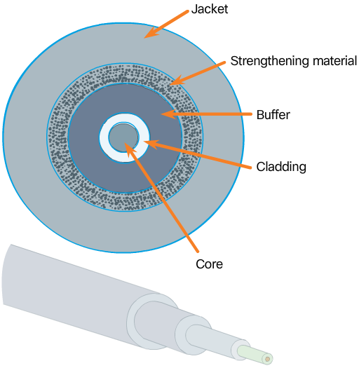
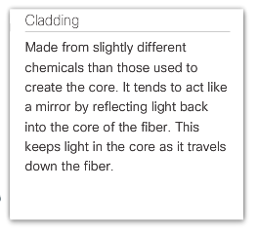
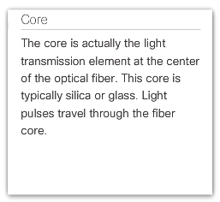
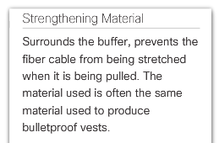
Fiber Media Cable Design
Notes:
4.2.3.2 Fiber Media Cable Design

Slide 33
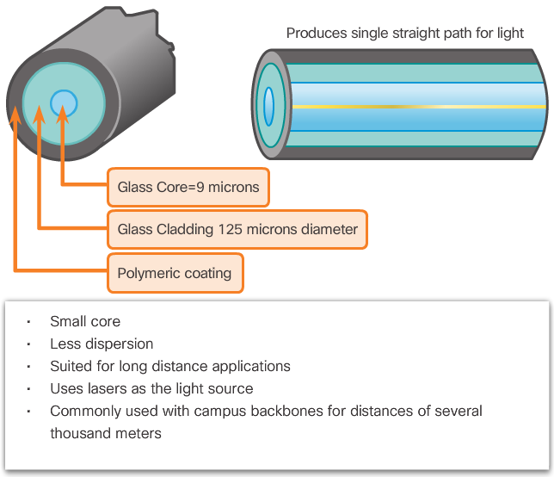
Types of Fiber Media
Single Mode
Notes:
4.2.3.3 Types of Fiber Media

Slide 34
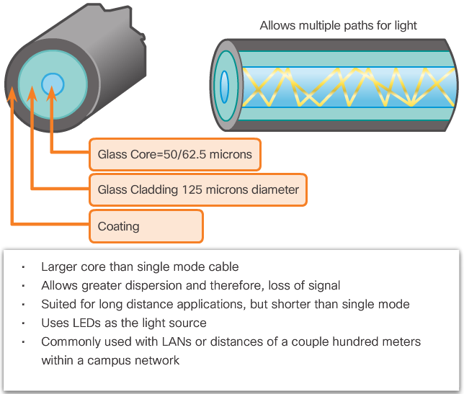
Types of Fiber Media (cont.)
Multimode
Notes:
4.2.3.3 Types of Fiber Media

Slide 35
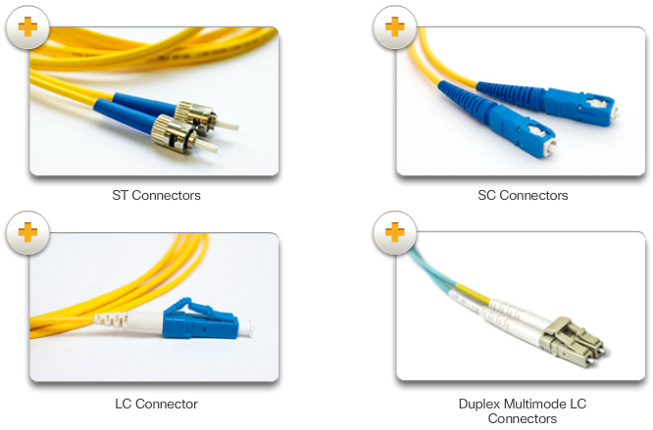
Network Fiber Connectors
Fiber Optic Connectors
Notes:
4.2.3.4 Network Fiber Connectors

Slide 36
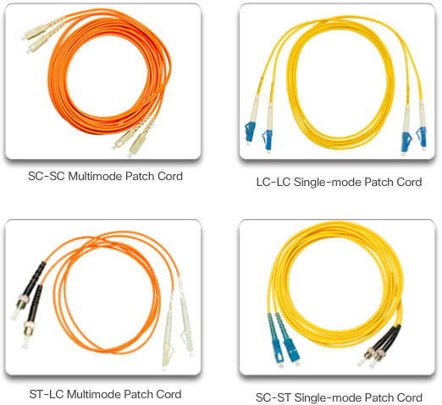
Network Fiber Connectors (cont.)
Common Fiber Patch Cords
Notes:
4.2.3.4 Network Fiber Connectors (Cont.)

Slide 37
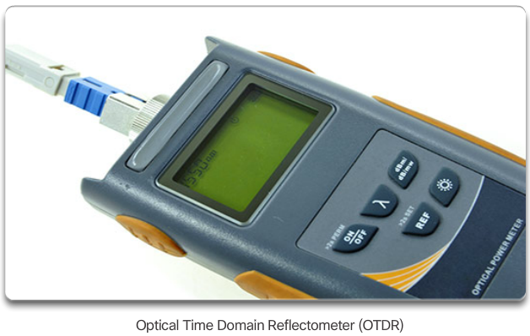
Testing Fiber Cables
Notes:
4.2.3.5 Testing Fiber Cables

Slide 38
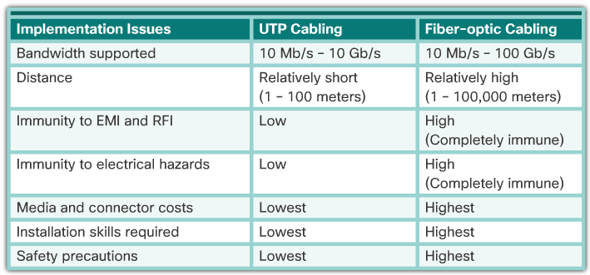
Fiber versus Copper
Notes:
4.2.3.6 Fiber versus Copper
4.2.3.7 Activity – Fiber Optics Terminology

Slide 39
Topic 4.2.4: Wireless Media

Slide 40
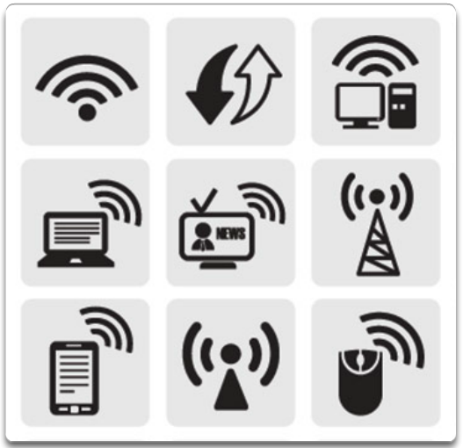
Properties of Wireless Media
Notes:
4.2.4.1 Properties of Wireless Media

Slide 41
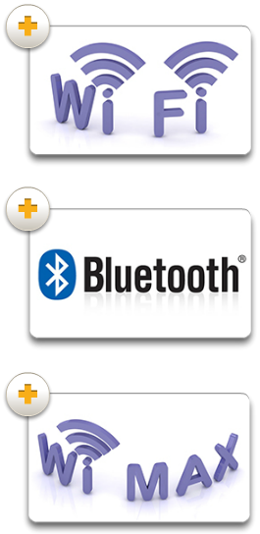
Types of Wireless Media
Notes:
4.2.4.2 Types of Wireless Media

Slide 42
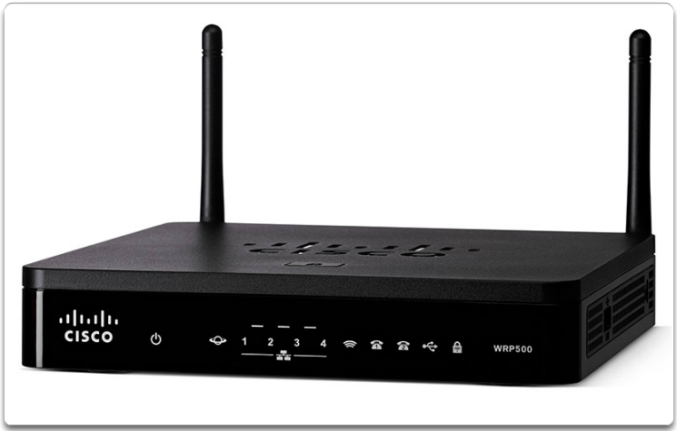
Wireless LAN
Notes:
4.2.4.3 Wireless LAN
4.2.4.4 Packet Tracer – Connecting a Wired and Wireless LAN
4.2.4.5 Lab – Viewing Wired and Wireless NIC Information

Slide 43
Section 4.3: Data Link Layer Protocols
Upon completion of this section, you should be able to:
Describe the purpose and function of the data link layer in preparing communication for transmission on specific media.

Slide 44
Topic 4.3.1: Purpose of the Data Link Layer

Slide 45
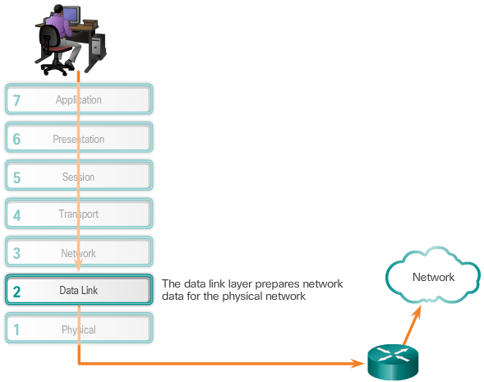
The Data Link Layer
Notes:
4.3.1.1 The Data Link Layer

Slide 46
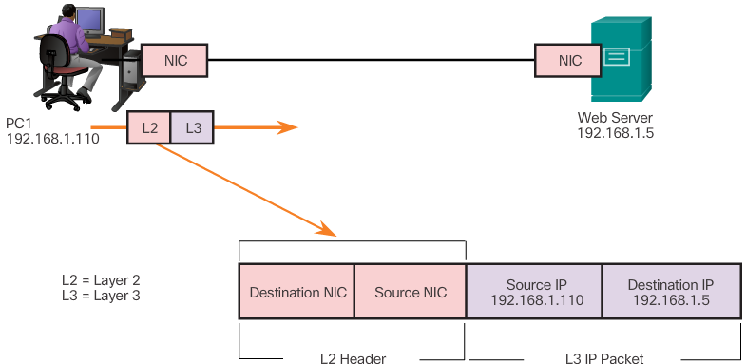
The Data Link Layer (cont.)
Layer 2 Data Link Address
Notes:
4.3.1.1 The Data Link Layer (Cont.)

Slide 47
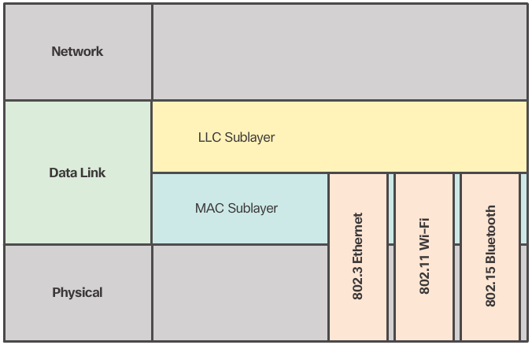
Data Link Sublayers
Notes:
4.3.1.2 Data Link Sublayers

Slide 48
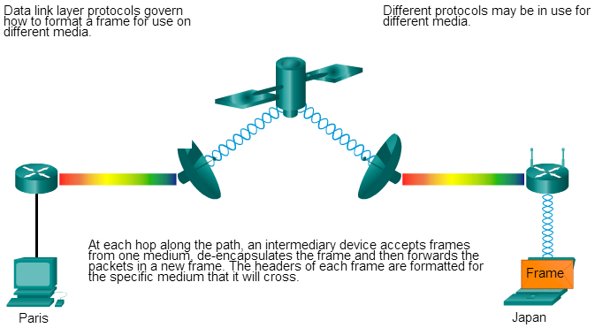
Media Access Control
Notes:
4.3.1.3 Media Access Control

Slide 49
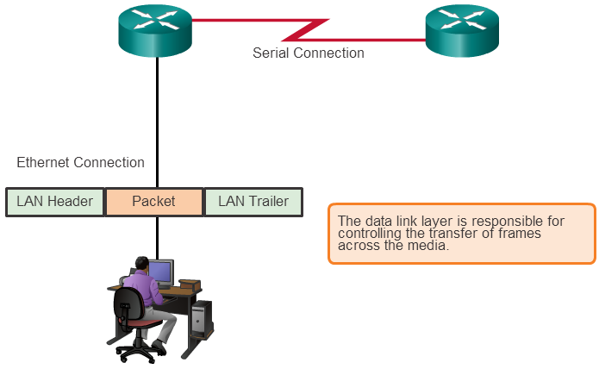
Providing Access to Media
Notes:
4.3.1.4 Providing Access to Media

Slide 50

Data Link Layer Standards
Notes:
4.3.1.5 Data Link Layer Standards

Slide 51
Section 4.4: Media Access Control
Upon completion of this section, you should be able to:
Compare the functions of logical topologies and physical topologies.
Describe the basic characteristics of media access control methods on WAN topologies.
Describe the basic characteristics of media access control methods on LAN topologies.
Describe the characteristics and functions of the data link frame.

Slide 52
Topic 4.4.1: Topologies

Slide 53
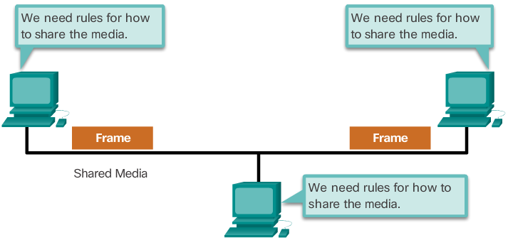
Controlling Access to the Media
Notes:
4.4.1.1 Controlling Access to the Media

Slide 54

Physical and Logical Topologies
Physical Topology
Notes:
4.4.1.2 Physical and Logical Topologies

Slide 55

Physical and Logical Topologies (cont.)
Logical Topology
Notes:
4.4.1.2 Physical and Logical Topologies (Cont.)

Slide 56
Topic 4.4.2: WAN Topologies

Slide 57

Common Physical WAN Topologies
Notes:
4.4.2.1 Common Physical WAN Topologies

Slide 58

Physical Point-to-Point Topology
Notes:
4.4.2.2 Physical Point-to-Point Topology

Slide 59

Logical Point-to-Point Topology
Notes:
4.4.2.3 Logical Point-to-Point Topology

Slide 60

Logical Point-to-Point Topology (cont.)
Notes:
4.4.2.3 Logical Point-to-Point Topology (Cont.)

Slide 61
Topic 4.4.3: LAN Topologies

Slide 62

Physical LAN Topologies
Notes:
4.4.3.1 Physical LAN Topologies

Slide 63



Half and Full Duplex
Half-Duplex Communication
Full-Duplex Communication
Notes:
4.4.3.2 Half and Full Duplex

Slide 64

Media Access Control Methods
Contention-Based Access
Notes:
4.4.3.3 Media Access Control Methods

Slide 65

Media Access Control Methods (cont.)
Controlled Access
Notes:
4.4.3.3 Media Access Control Methods (Cont.)

Slide 66


Contention Based Access – CSMA/CD
Notes:
4.4.3.4 Contention Based Access – CSMA/CD

Slide 67

Contention Based Access – CSMA/CD (cont.)
Notes:
4.4.3.4 Contention Based Access – CSMA/CD (Cont.)

Slide 68

Contention Based Access – CSMA/CA
Notes:
4.4.3.5 Contention Based Access – CSMA/CA

Slide 69
Topic 4.4.4: Data Link Frame

Slide 70

The Frame
Frames have three basic parts:
Header
Data
Trailer
Notes:
4.4.4.1 The Frame

Slide 71

Frame Fields
Notes:
4.4.4.2 Frame Fields
4.4.4.3 Activity – Generic Frame Fields

Slide 72

Layer 2 Address
Notes:
4.4.4.4 Layer 2 Address

Slide 73

Layer 2 Address (cont.)
Notes:
4.4.4.4 Layer 2 Address (Cont.)

Slide 74

Layer 2 Address (cont.)
Notes:
4.4.4.4 Layer 2 Address (Cont.)

Slide 75
LAN and WAN Frames
Examples of Layer 2 protocols:
802.11 Wireless Frame
PPP Frame
HDLC
Frame Relay
Ethernet Frame
Notes:
4.4.4.5 LAN and WAN Frames

Slide 76
Section 4.5: Summary
Chapter Objectives:
Explain how physical layer protocols and services support communications across data networks.
Build a simple network using the appropriate media.
Explain how the Data Link layer supports communications across data networks.
Compare media access control techniques and logical topologies used in networks.
Notes:
4.5.1.1 Class Activity - Linked In!
4.5.1.2 Chapter 4: Network Access

